Slide 1
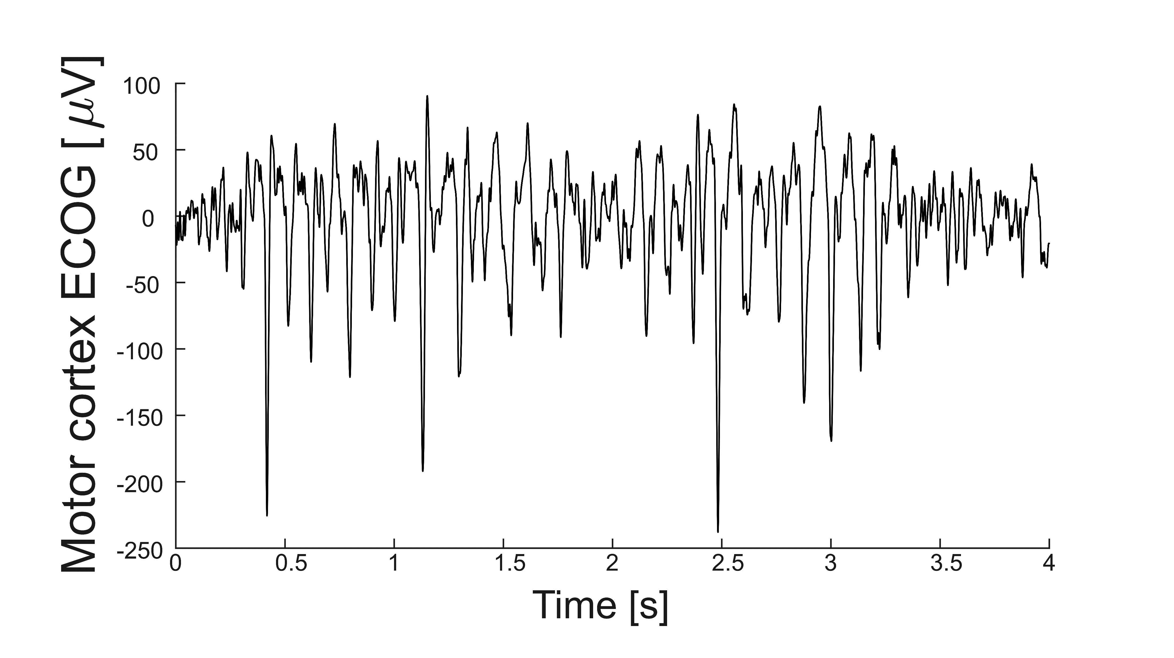

ReTune Early Career Methods Workshop: Basic introduction to invasive neurophysiology
B03 Neumann
C01 Florin

Slide 2
Requirements:
Software: Matlab, if you have access, please install Matlab 2020b
Python/Anaconda including Jupyter
GitHub code repositories: https://github.com/retune-commons/InvasiveElectrophysiologyWorkshop_I
https://github.com/neuromodulation/wjn_toolbox/
https://github.com/spm/spm12
https://github.com/fieldtrip/fieldtrip.git
Python packages:
MNE toolbox, can be installed using the following command in a Jupiter notebook:
import sys
!{sys.executable} -m pip install mne
Please have a computer ready with Matlab and Anaconda installed.
Clone the identified repositories and create a working directory.

Slide 3
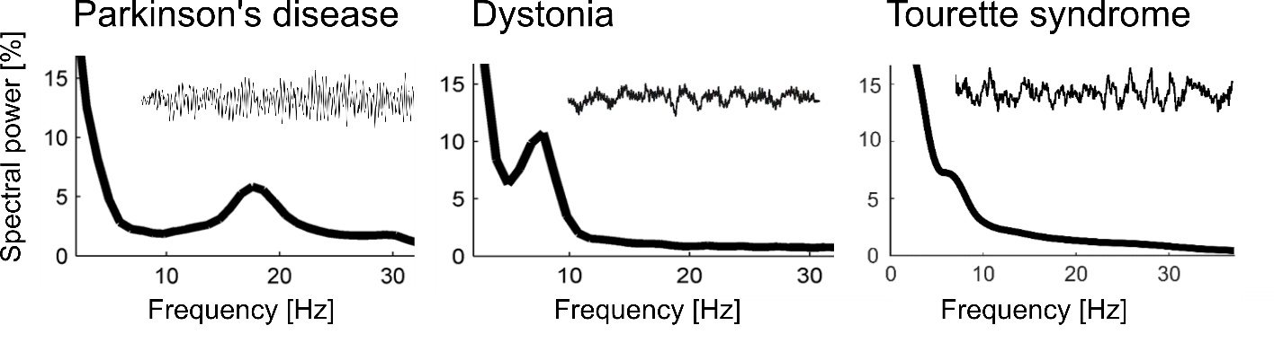
Invasive neurophysiology research in DBS patients

Slide 4
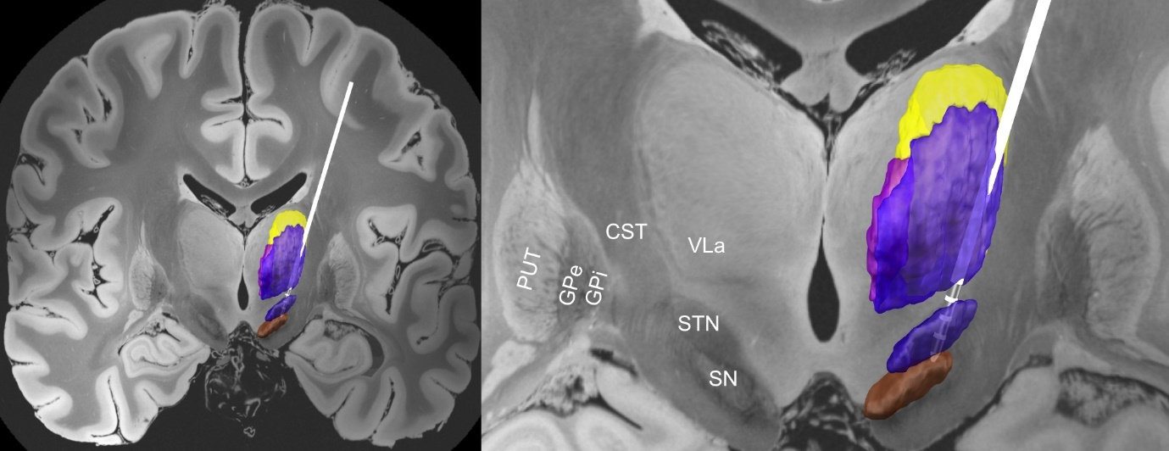
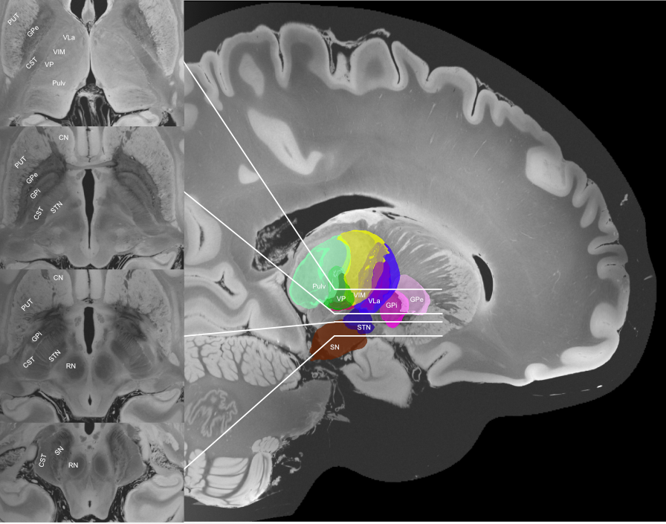
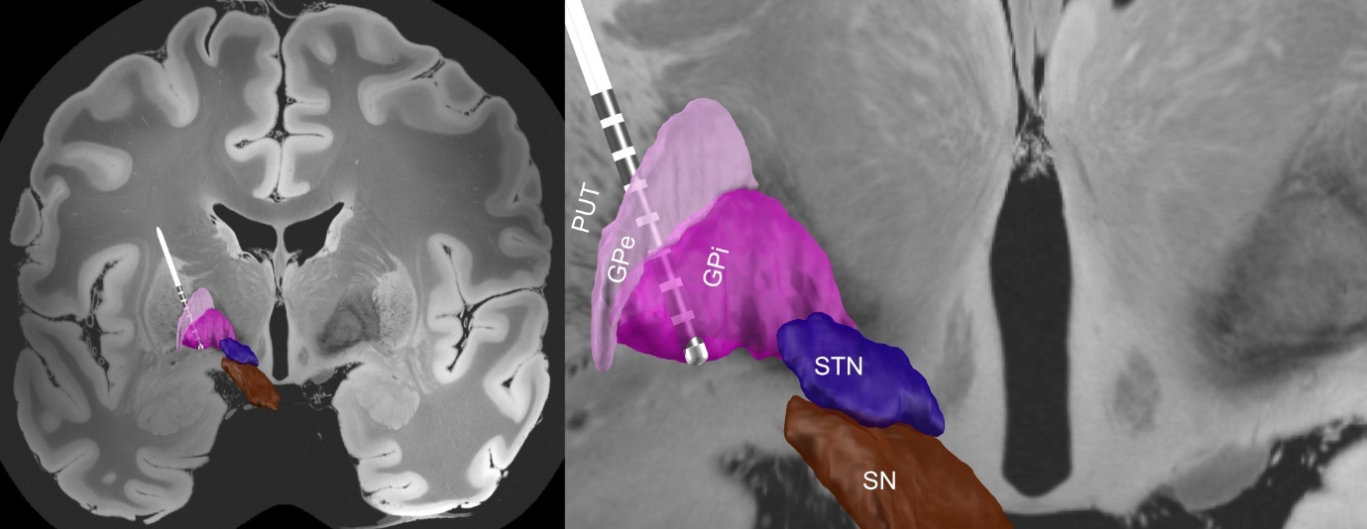
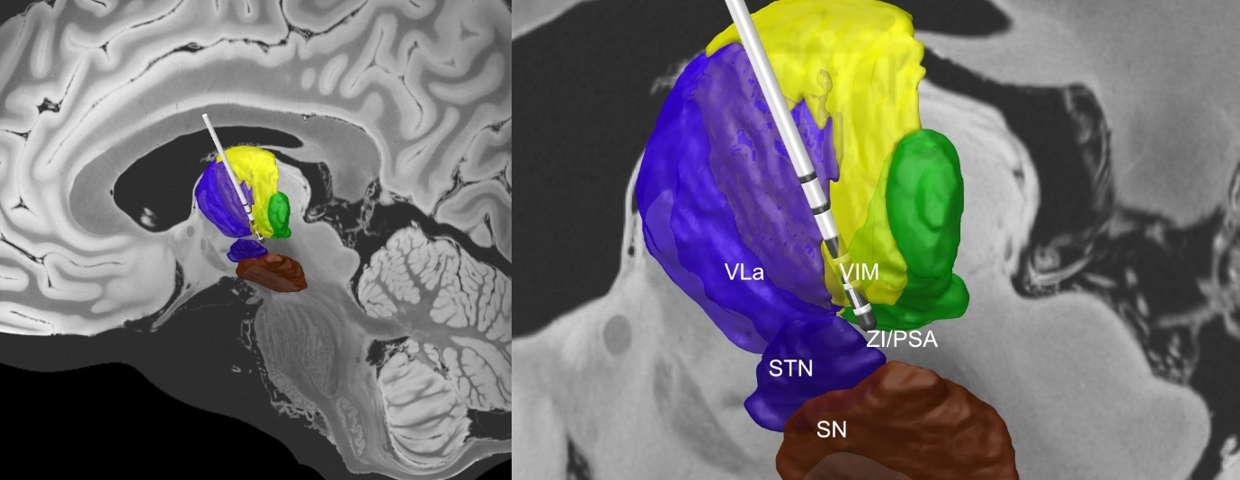

Slide 5
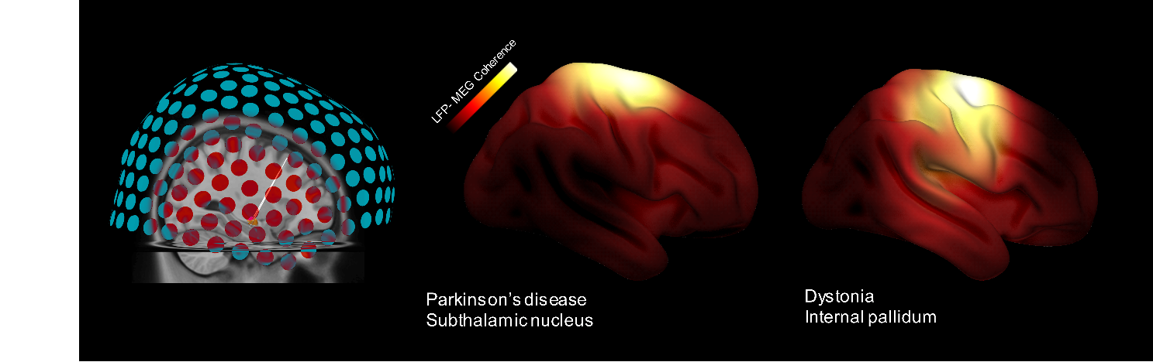
Combined LFP and whole-head recordings

Slide 6
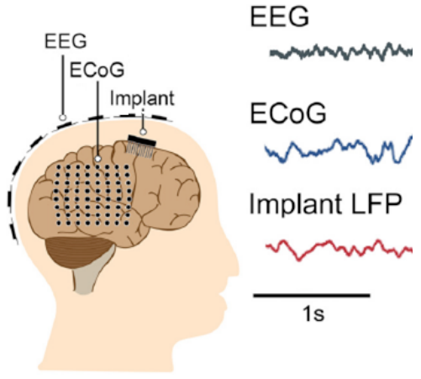
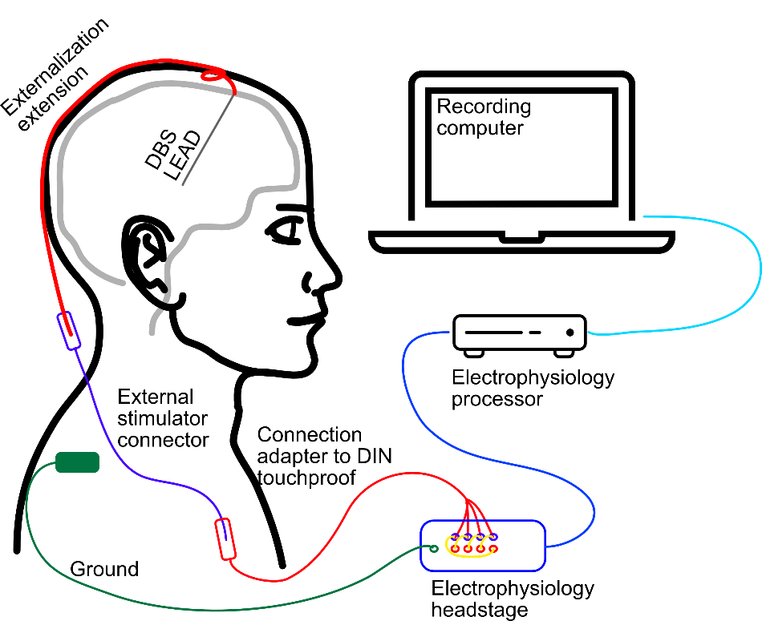
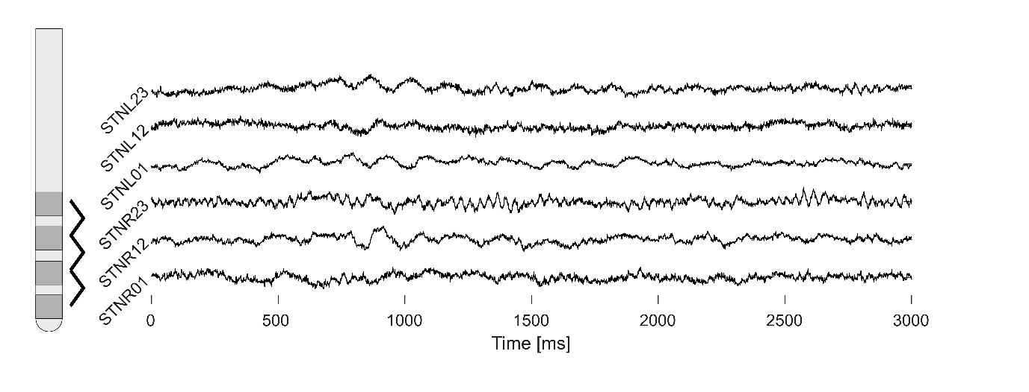

Slide 7
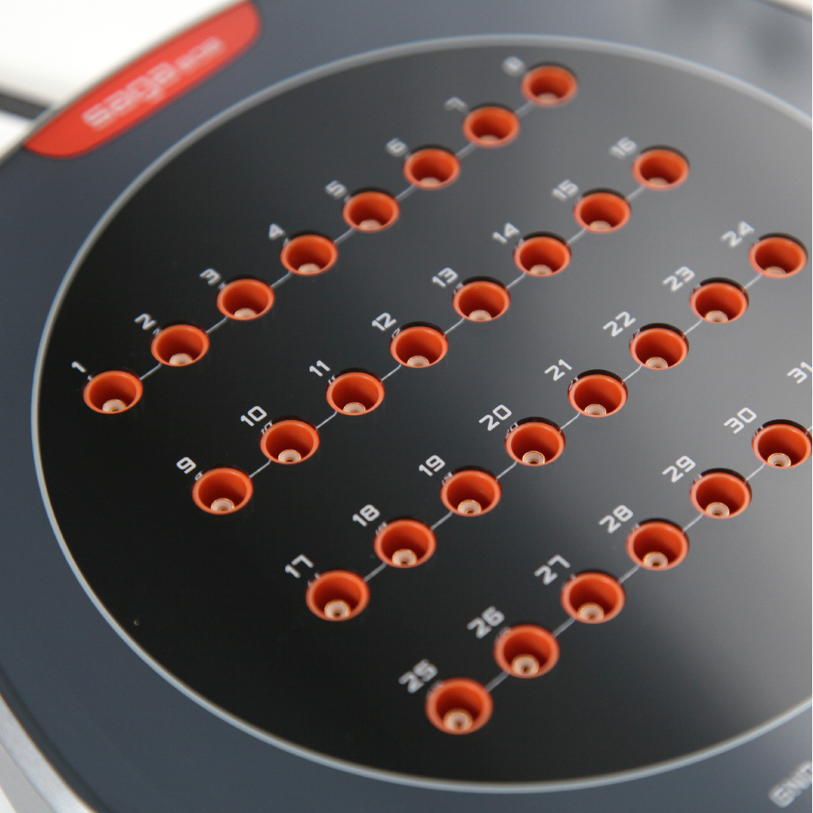
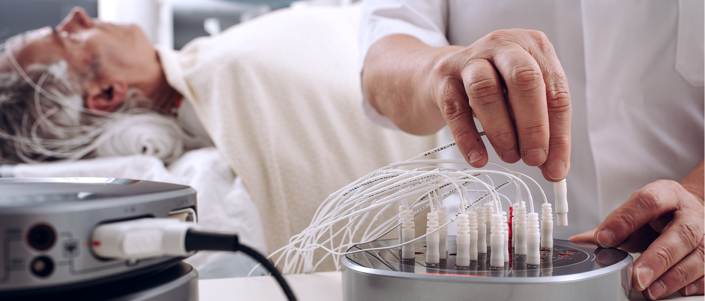
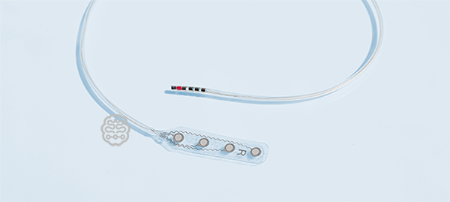
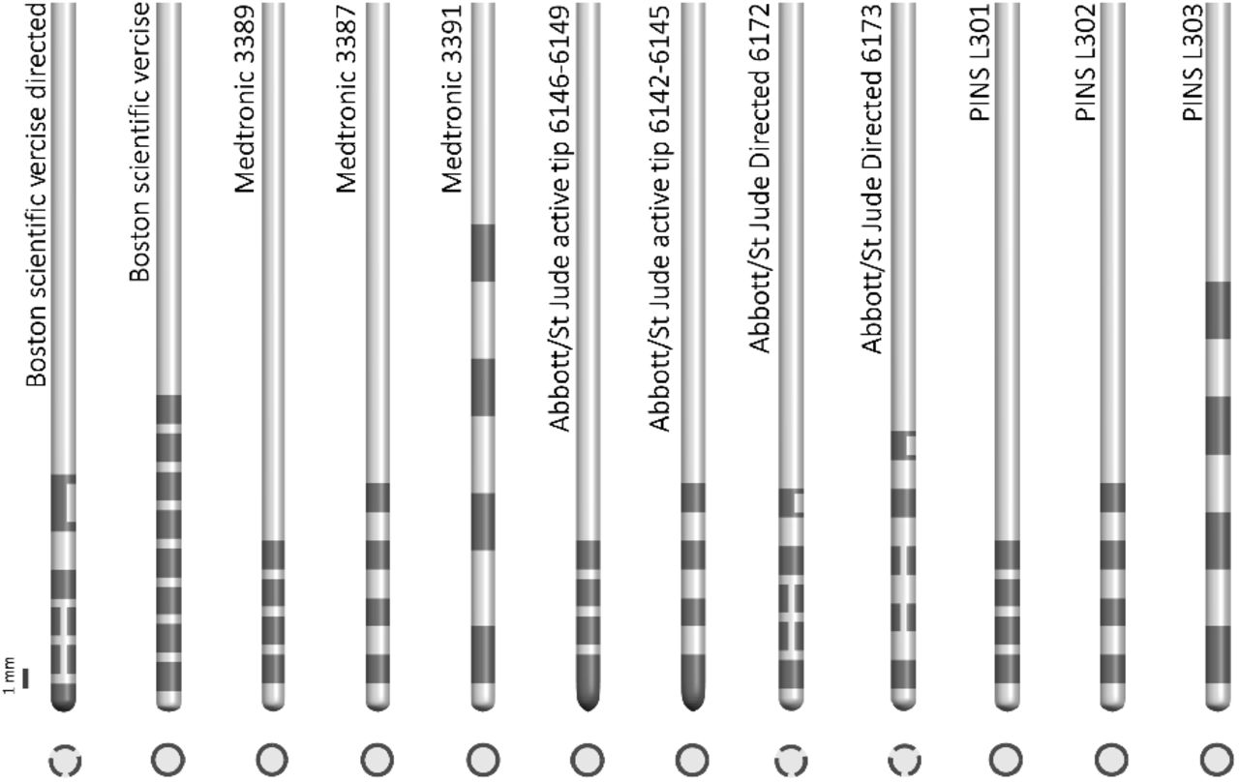
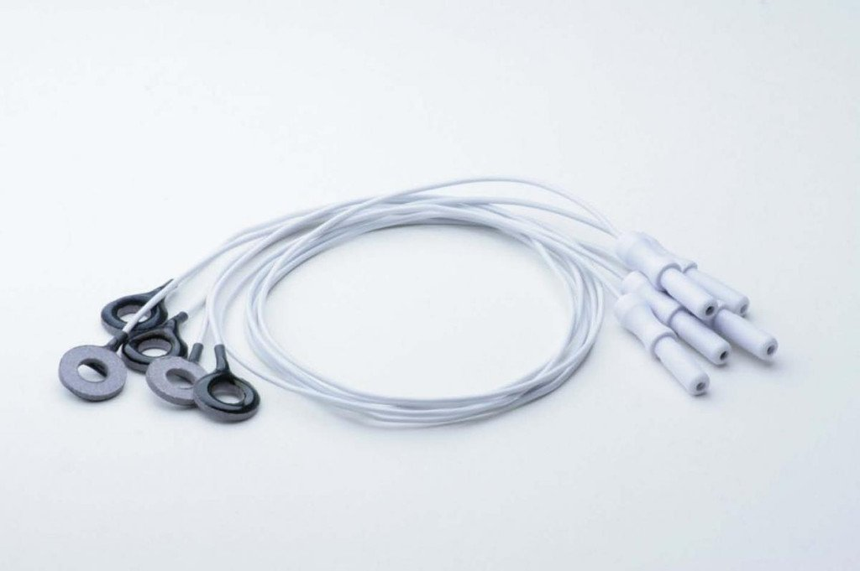

Slide 8
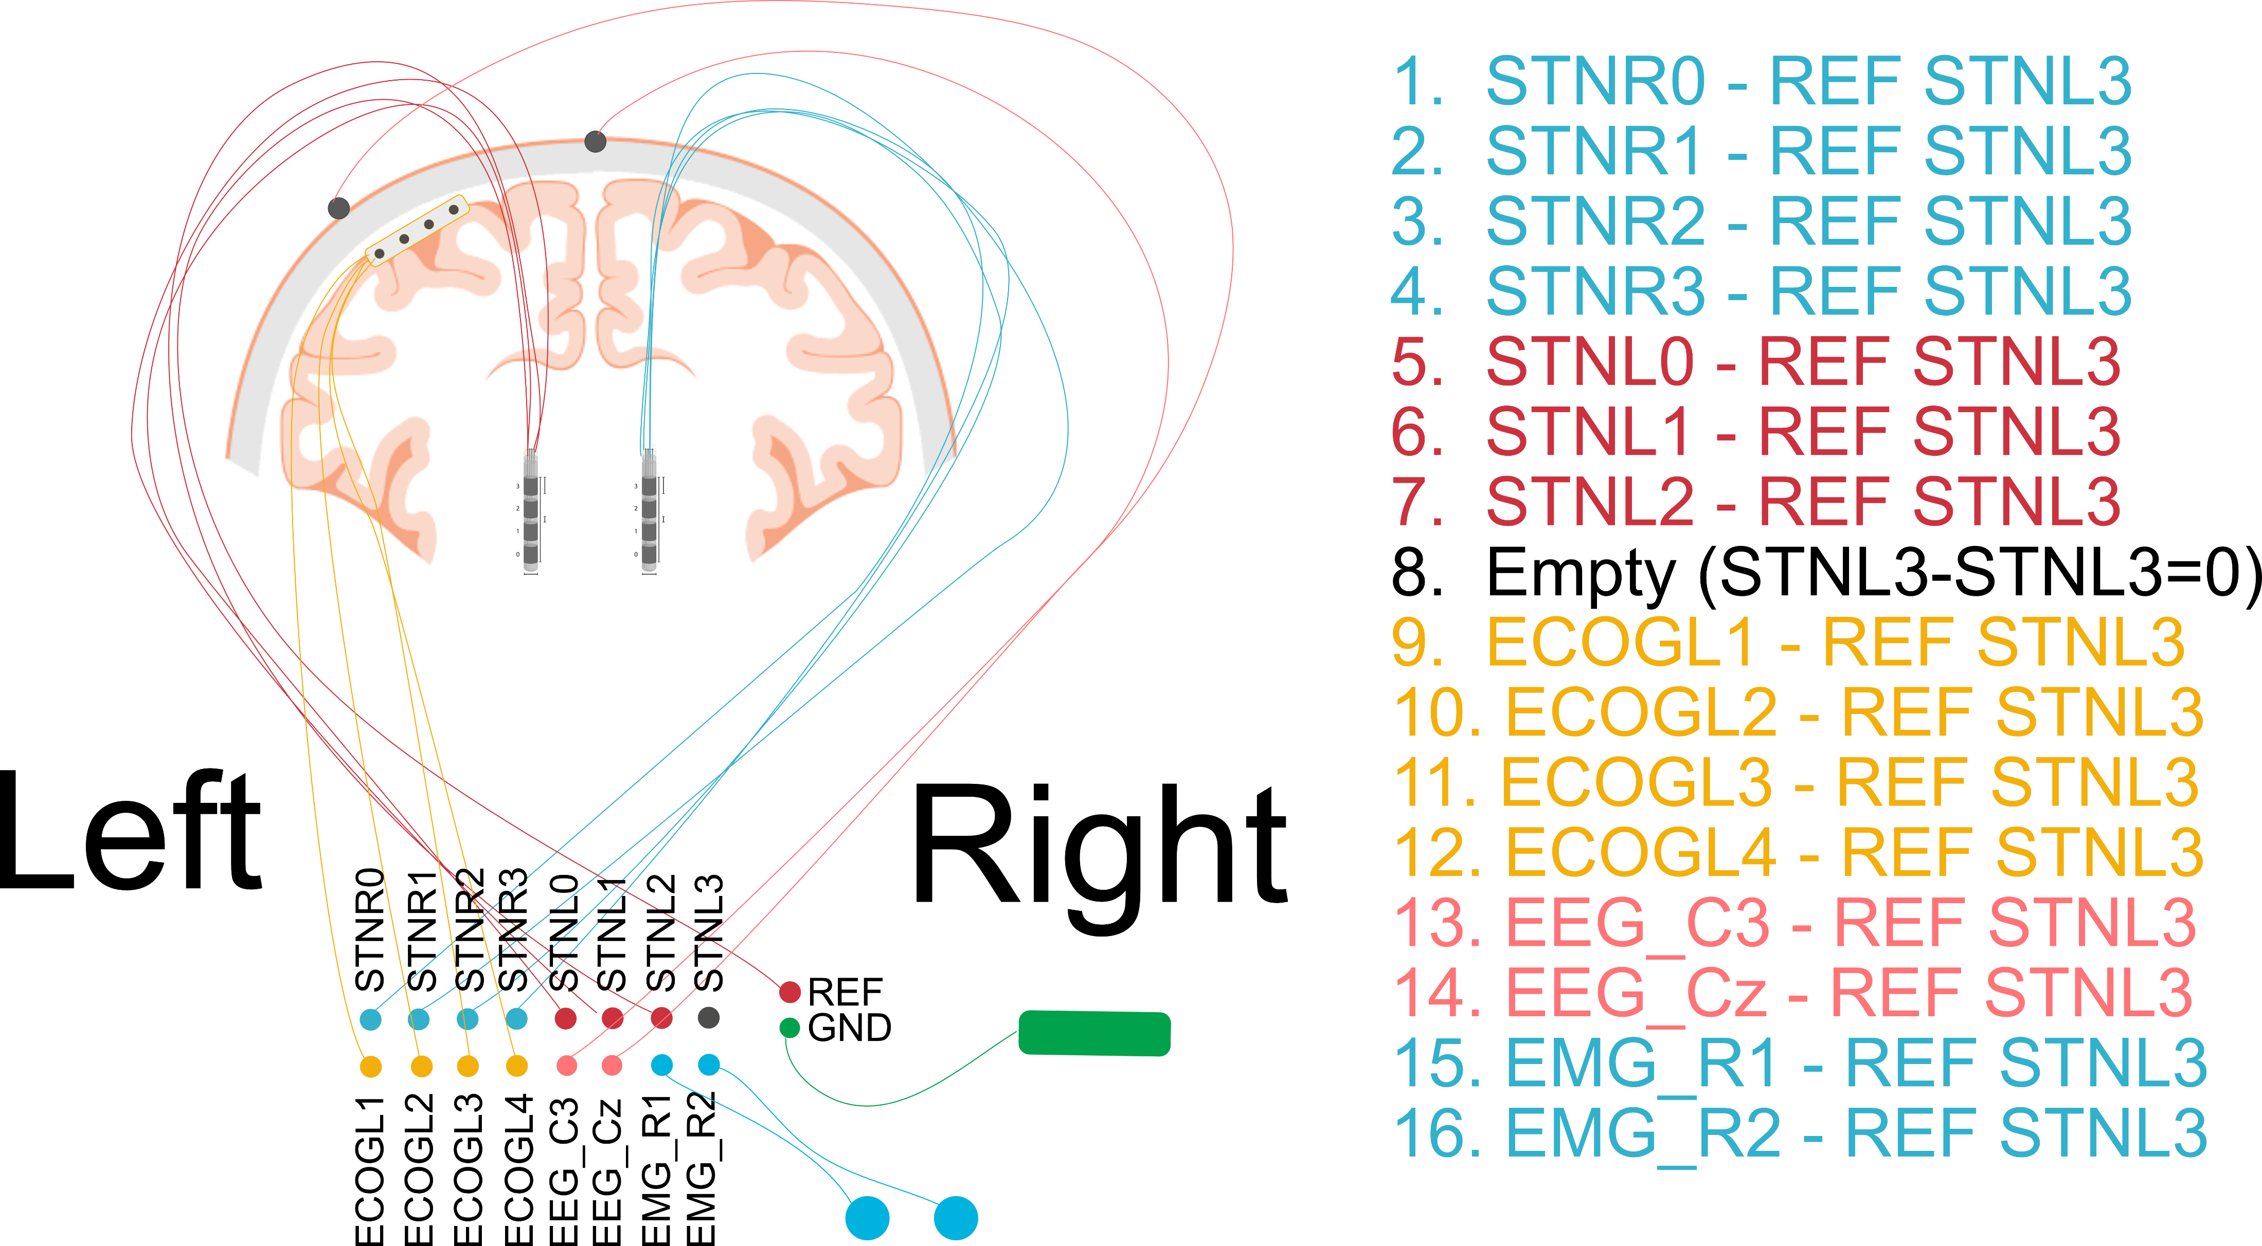

Slide 9
Practical rules of thumb
Connectors and adapters can be a source of bad signal quality. Check and replace regularly.
Turn of any unrequired electric device to reduce 50 Hz noise.
Ground and reference need to be good, otherwise all signals are bad.
Smaller contacts have higher impedance and therefore smaller signals.
Let’s open Matlab now.

Slide 10
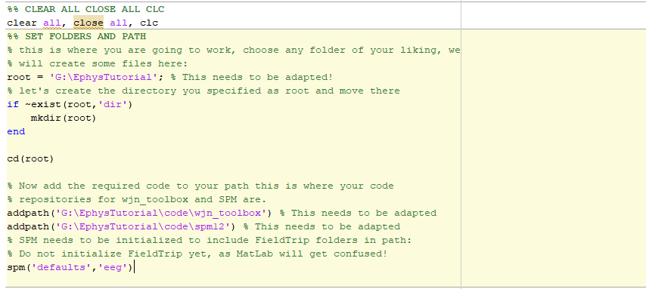
Setting the path: change the folders in your version of the code
Tutorial_I_Import_and_rereference.m

Slide 11
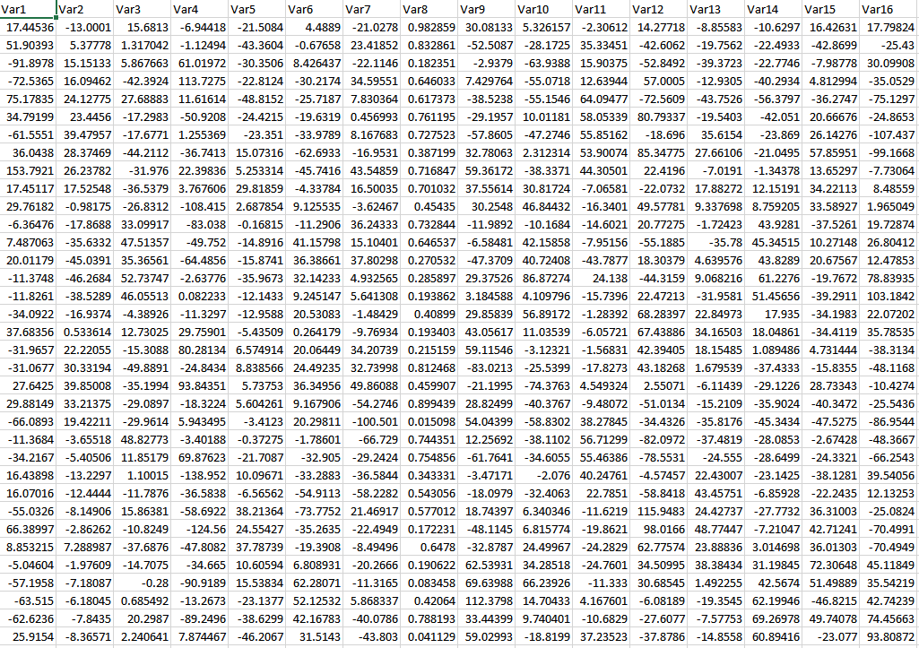
Simulate Time-Series Data
CSV file with 16 time-series columns in forgotten_trashy_dataset.csv
Additional info in trashy_info.txt

Slide 13
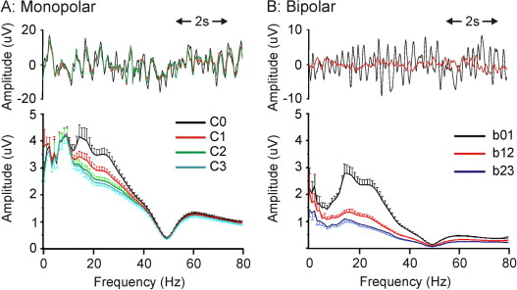
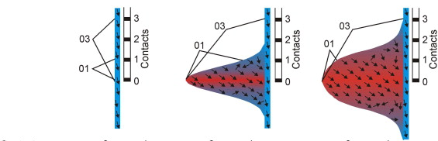
Rereferencing LFP
Bipolar rereferencing serves a more focal analysis.

Slide 14
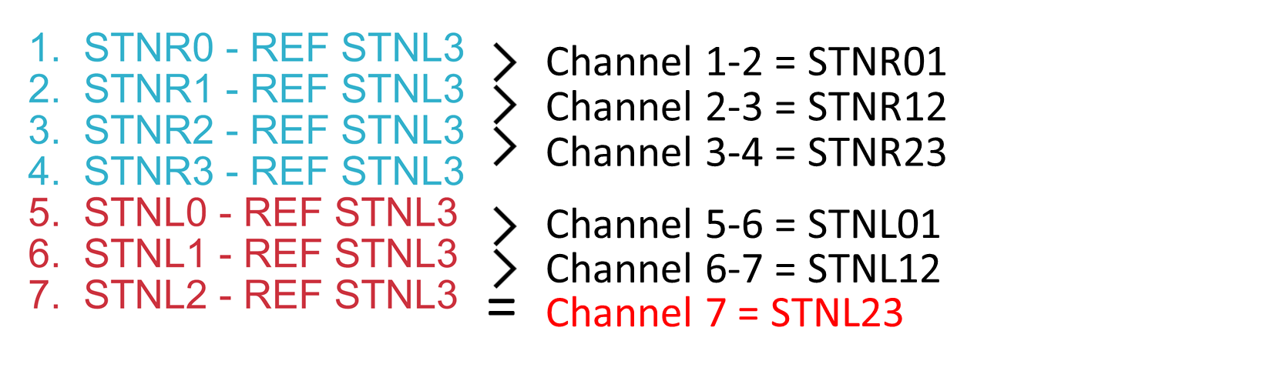
Rereferencing should always be done as the first step of any further processing!
For bipolar rereferencing subtract adjacent recordings.
Note that Channel 7 is already hardware bipolar.

Slide 15
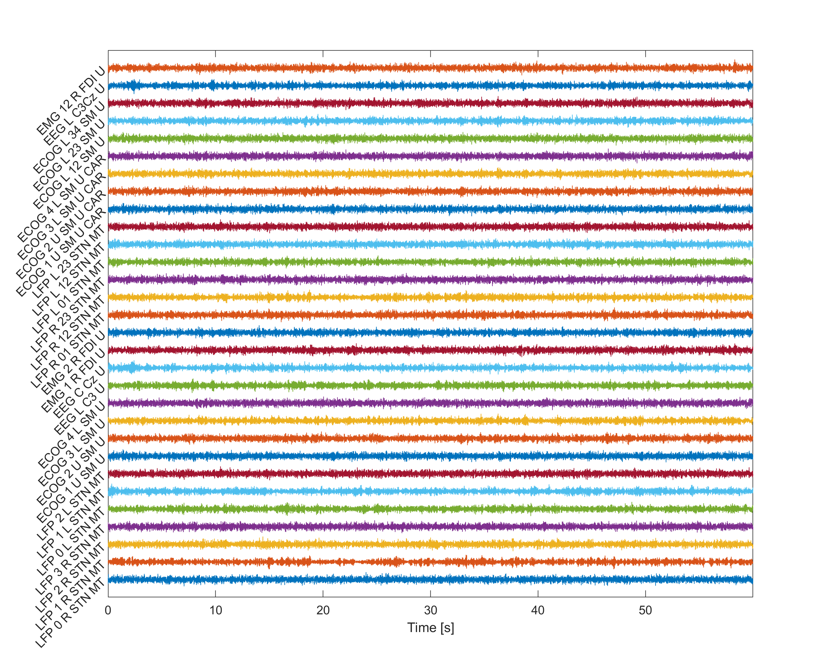
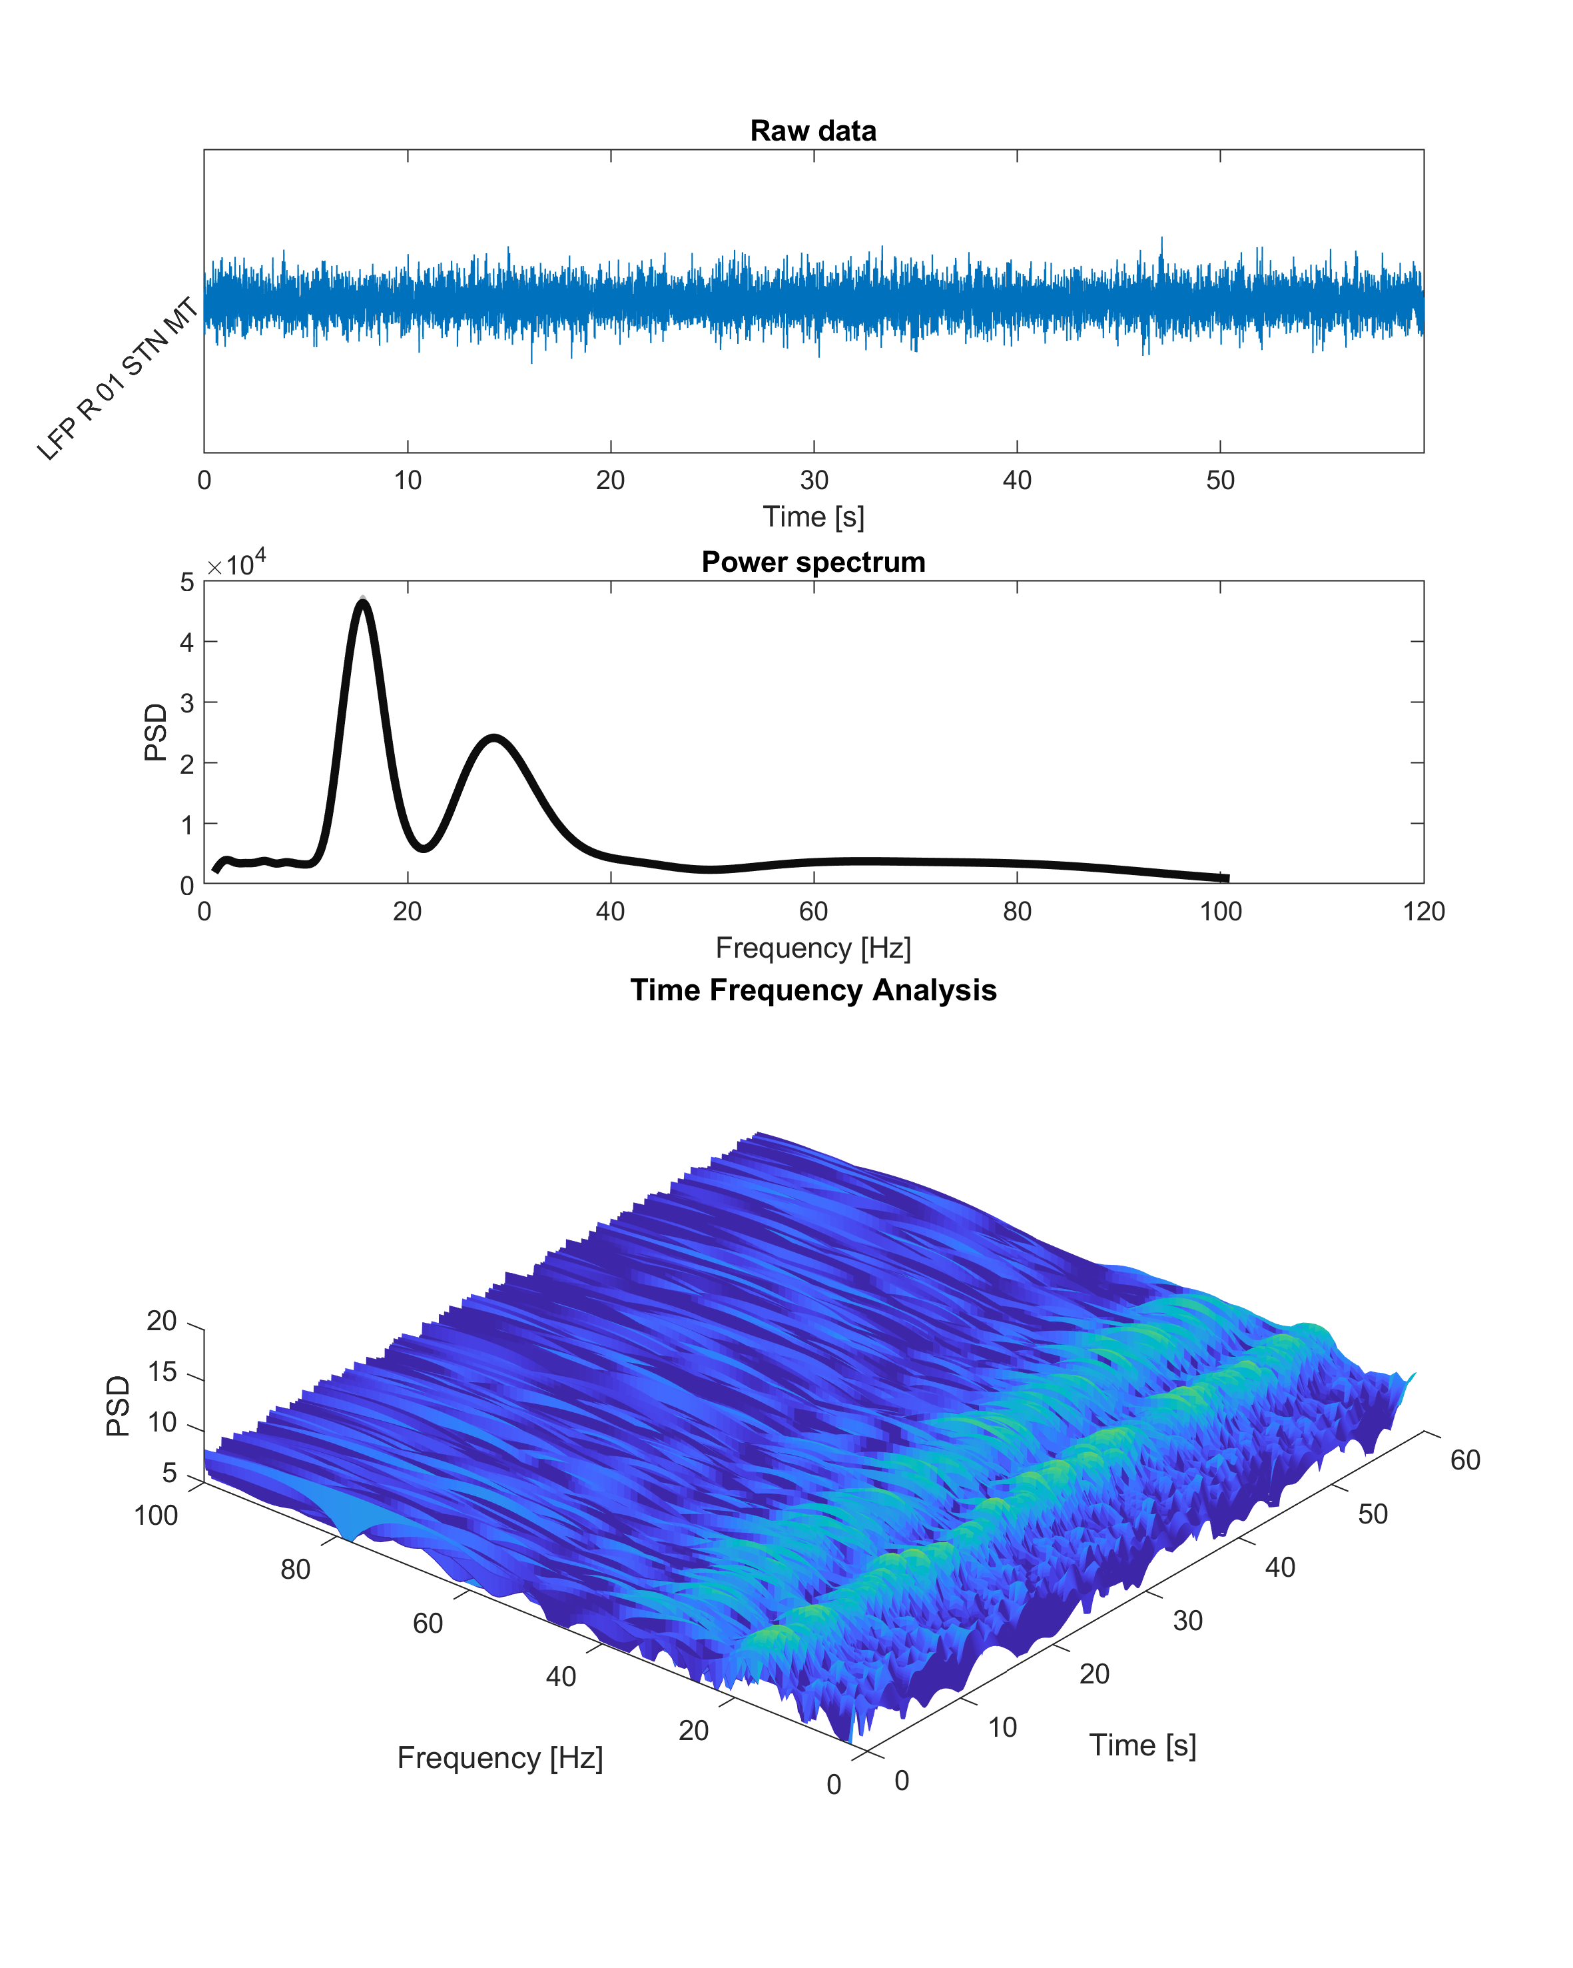
Dataset milestone: Rereferenced and clean.

Slide 16

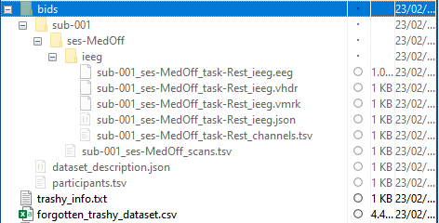
https://www.nature.com/articles/s41597-019-0105-7.pdf

Slide 17

Let‘s move to Python now

